Slide 1
SAQA: fit for purpose and future → strategic themes and intent
Journeys and roadmaps
Specific themes on the evolving world of work
PM external and internal fit: value proposition and people strategic agenda

Slide 2
Restructure consolidation and review
Institutional memory and culture
Automation
Future landscape, ecosystem + strategy and shape of SAQA
SAQA fit for purpose and the future
Strategic themes and intent

Slide 3
SAQA fit for purpose and the future
Restructure consolidation and review
Institutional memory and culture
Automation
Future landscape, ecosystem + strategy and shape of SAQA
recover and being responsive
consolidate, renew, and sustain (DNA)
co-create and grow future SAQA
Strategic themes and intent

Slide 4



SAQA fit for purpose and the future
Restructure consolidation and review
Institutional memory and culture
Automation
Future landscape, ecosystem + strategy and shape of SAQA
recover and being responsive
consolidate, review, and sustain (DNA)
co-create future SAQA
Strategic themes and intent

Slide 5
SAQA fit for purpose and the future
PM value proposition and people strategic agenda
PM strategy fit, organisational fit, & GRC
EVP + talent + leadership
PM architecture & internal fit
Value, delivery, & experiential platform
Measurement platform
Execution + learning + growth engines
Organisation fit for purpose
Strategic themes and intent

Slide 6
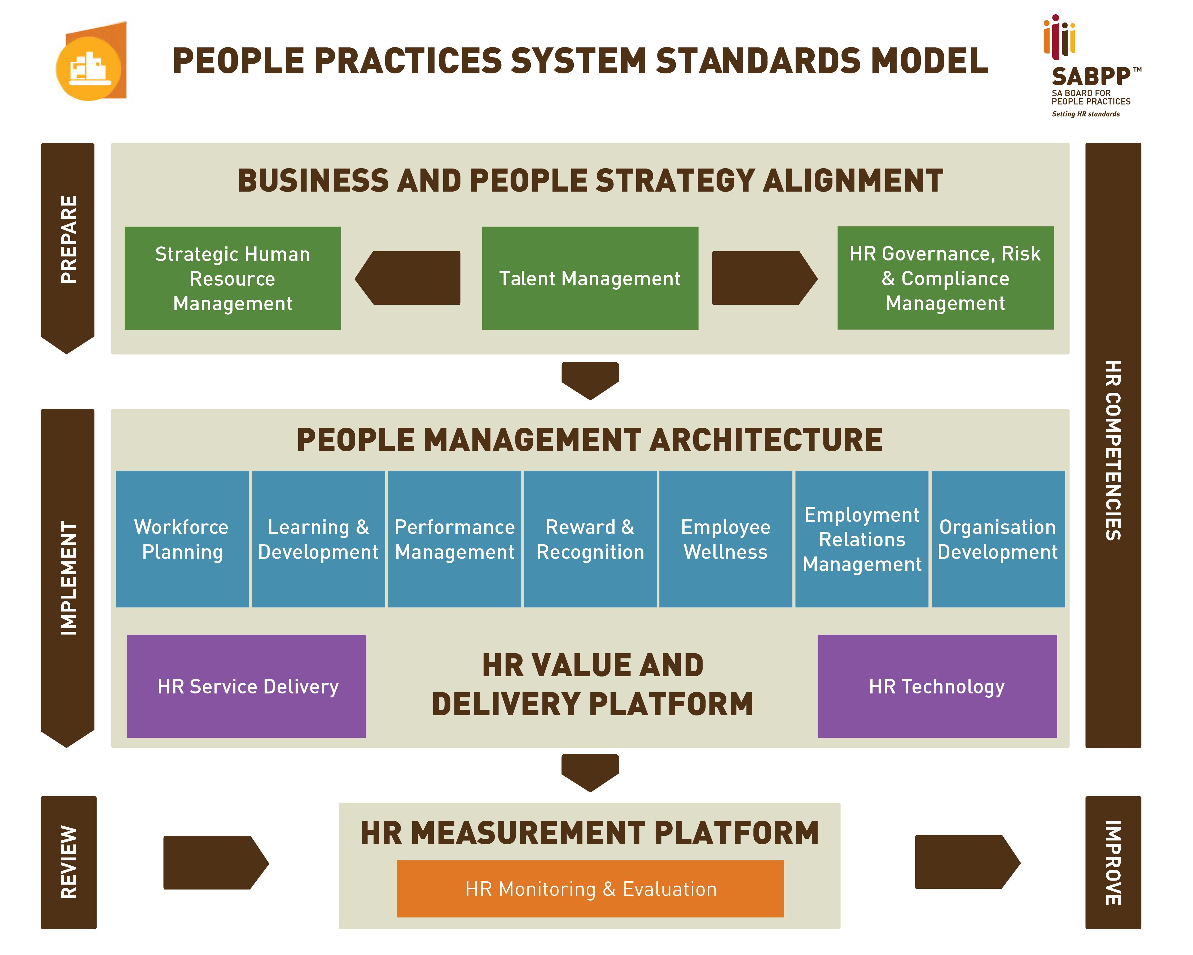
PM value proposition and people strategic agenda
PM strategy fit, organisational fit, & GRC
EVP + talent + leadership
PM architecture & internal fit
Value, delivery, & experiential platform
Measurement platform
Execution + learning + growth engines
Organisation fit for purpose

Slide 7

PM value proposition and people strategic agenda
Current socio-technical system
PM strategy fit, organisational fit, & GRC
EVP + talent + leadership
PM architecture & internal fit
Value, delivery, & experiential platform
Measurement platform
Execution + learning + growth engines
Organisation fit for purpose
Formal and informal organisation
?
Sage VIP 300
OS and work systems

Slide 8
PM value proposition and people strategic agenda
Approach
PM strategy fit, organisational fit, & GRC
EVP + talent + leadership
PM architecture & internal fit
Value, delivery, & experiential platform
Measurement platform
Execution + learning + growth engines
Organisation fit for purpose
engage
embrace
experiment
expand
evaluate

Slide 9
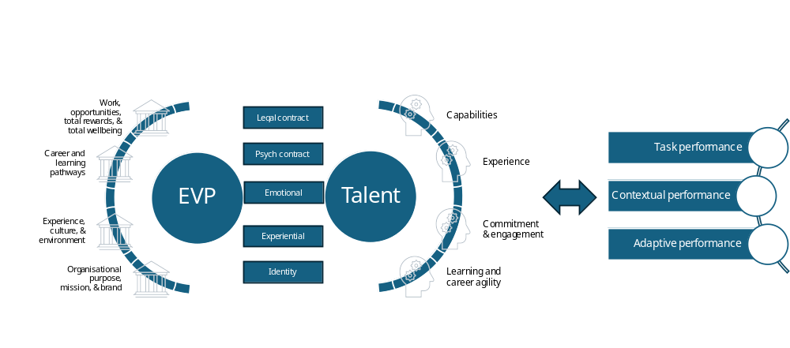
EVP and talent journey

Slide 10


EVP and talent journey
theme
theme
theme
SAQA value journey

Slide 11
EVP and talent journey
Performance journey

Slide 12
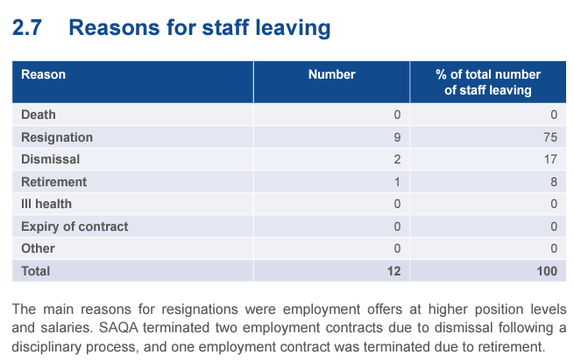
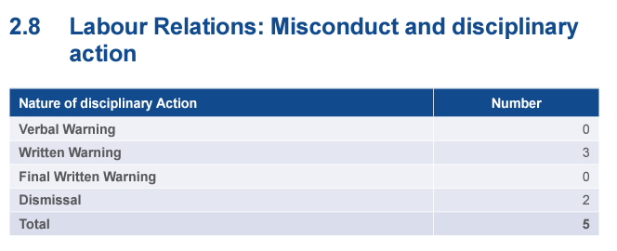
EVP and talent journey
Performance journey

Slide 13
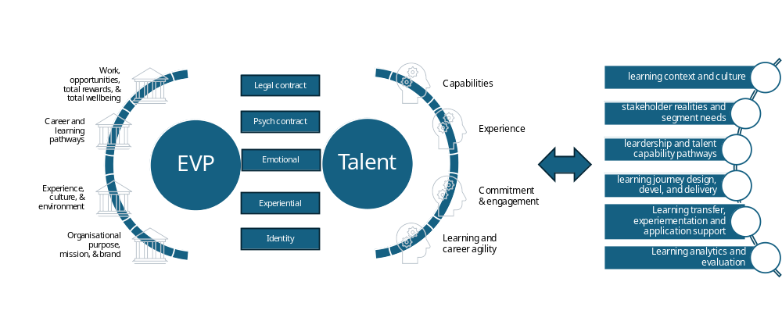
EVP and talent journey
Learning journey

Slide 14


organisational cycle
Culture roadmap
Leadership roadmap
Talent roadmap
Learning roadmap
Performance roadmap
PM cycle

Slide 15
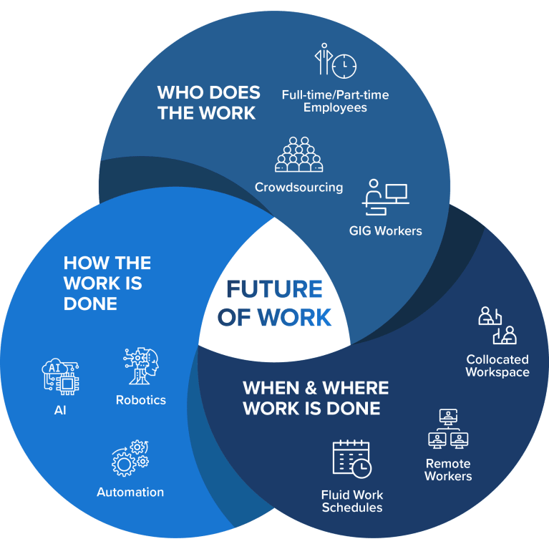

Slide 16
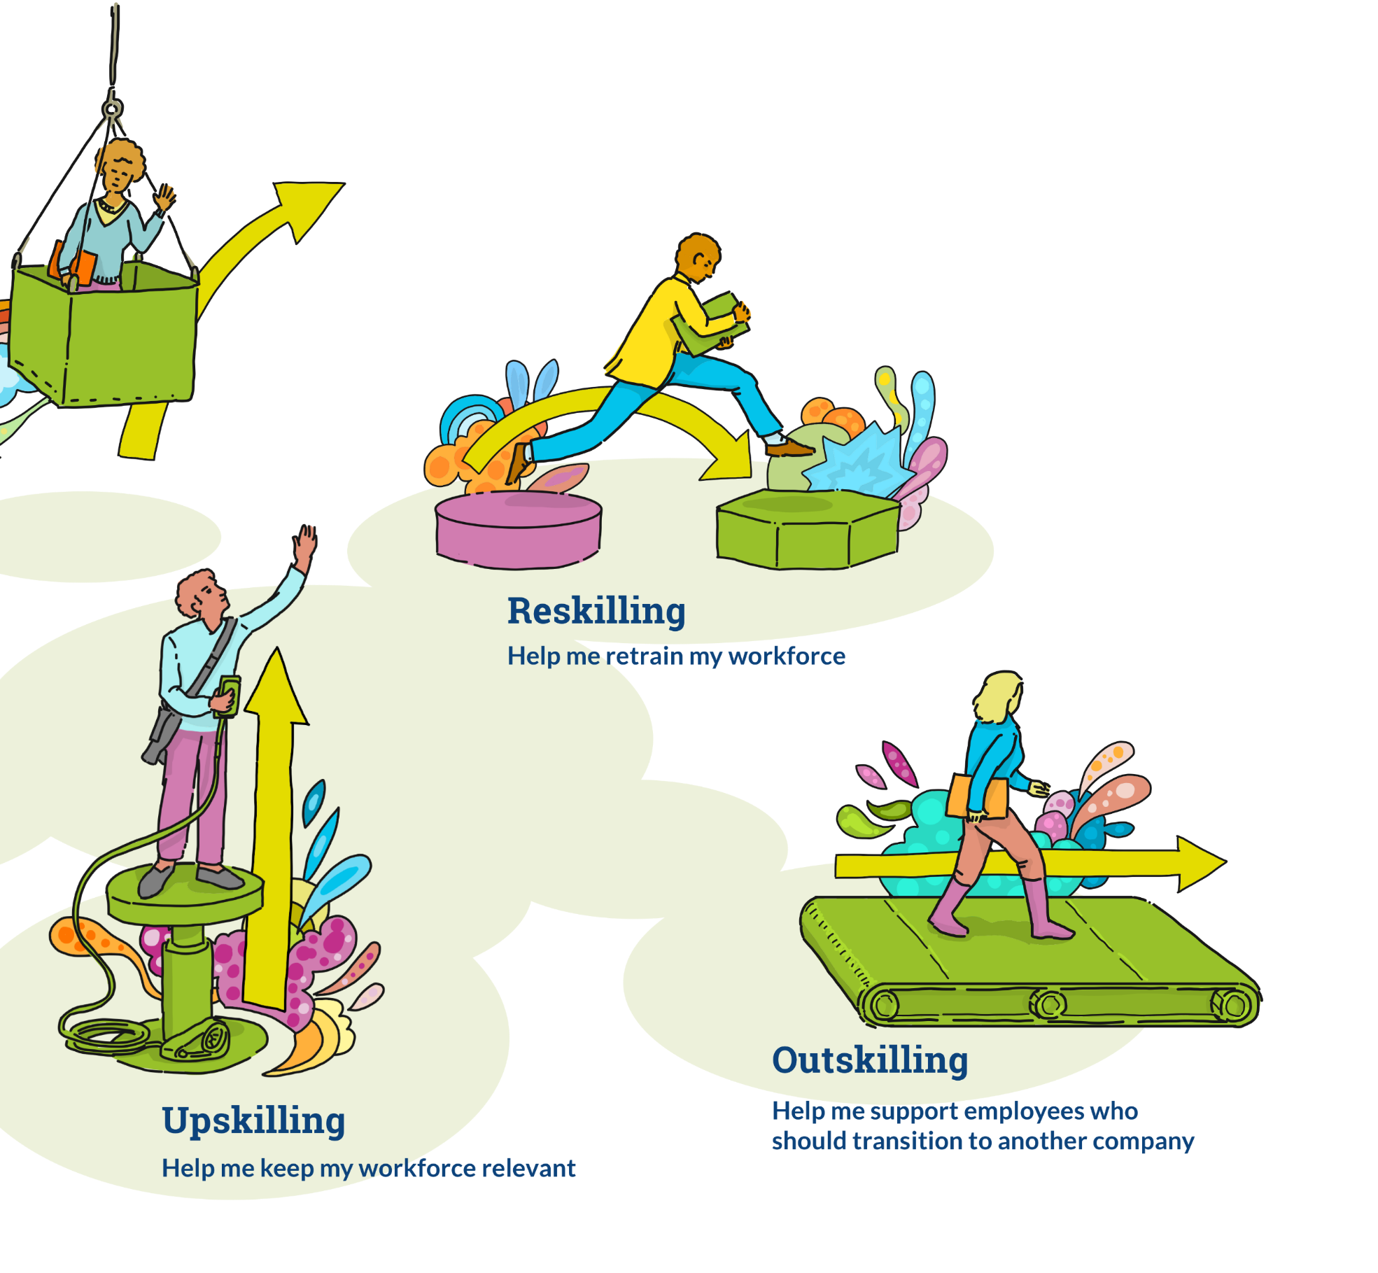
Leveraging formal, informal, and non-formal learning
Leveraging instructor-led, self, peer, and shared learning

Slide 17
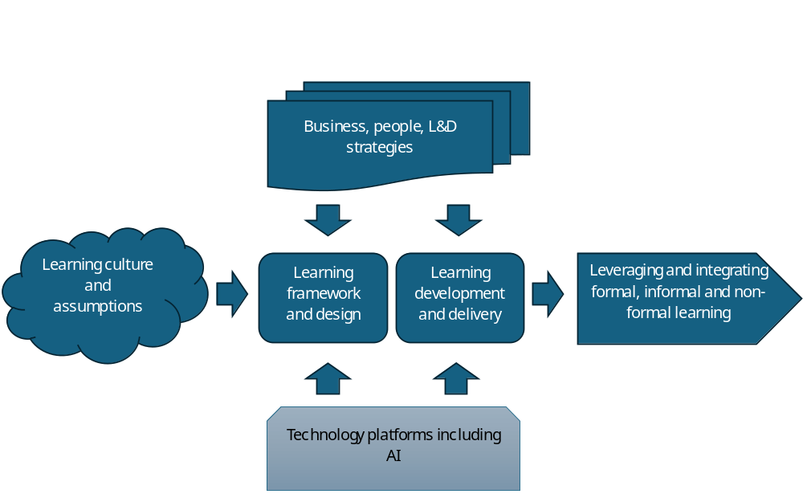
Leveraging formal, informal, and non-formal learning
Leveraging instructor-led, self, peer, and shared learning

Slide 18

Leveraging formal, informal, and non-formal learning
Career architecture
Leveraging instructor-led, self, peer, and shared learning

Slide 19
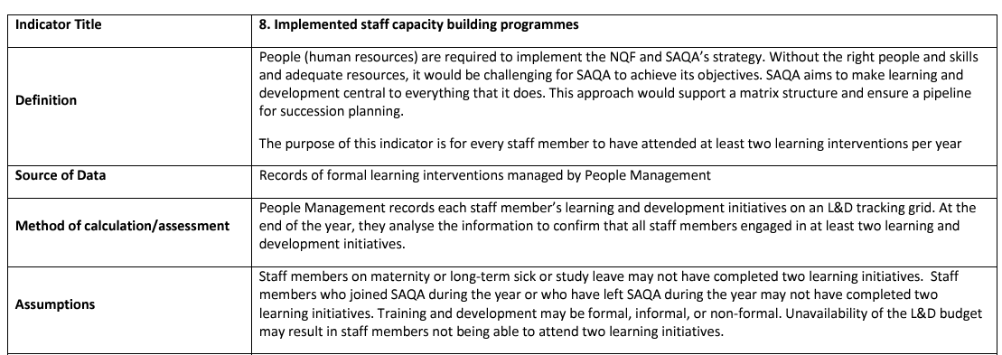
Leveraging formal, informal, and non-formal learning
Career architecture
Leveraging instructor-led, self, peer, and shared learning

